Slide 1

PROJECT RESUME CLASSIFICATION

Slide 2

BUSINESS OBJECTIVE
The document classification solution should significantly reduce the manual human effort in the HRM. It should achieve a higher level of accuracy and automation with minimal human intervention.

Slide 3

PROJECT OBJECTIVES
EDA
Model Building
Model Evaluation and Feedback
Deployment
Final Presentation

Slide 4
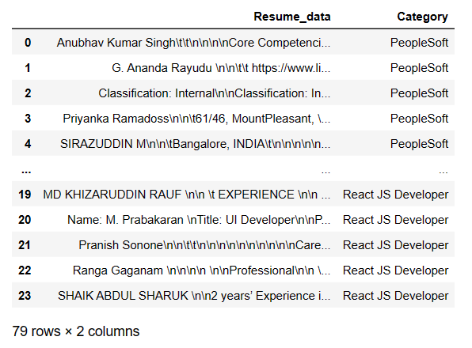
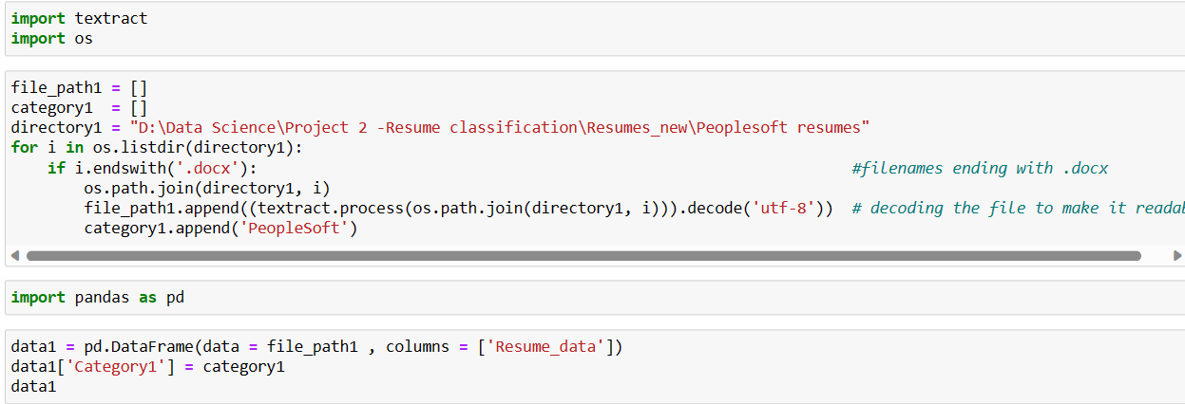
Exploratory Data Analysis(EDA)
Extraction of text using textract module from all the resume files and also distributing them into four different categories.

Slide 5
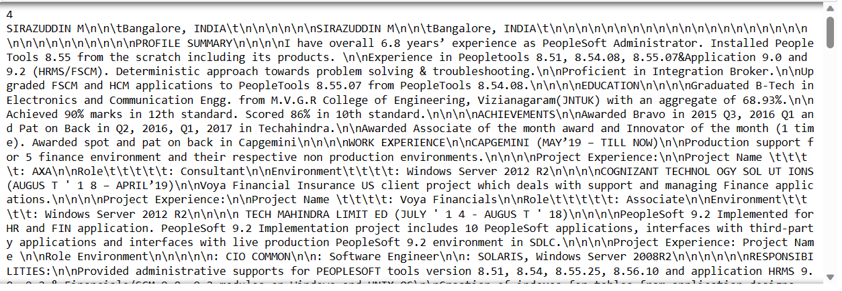
Example of a resume in Dataframe

Slide 6
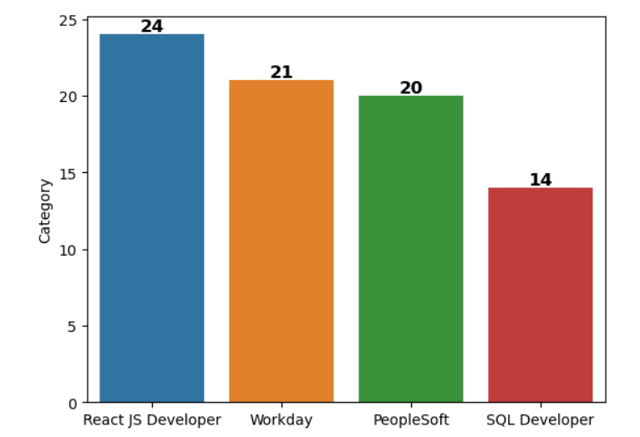
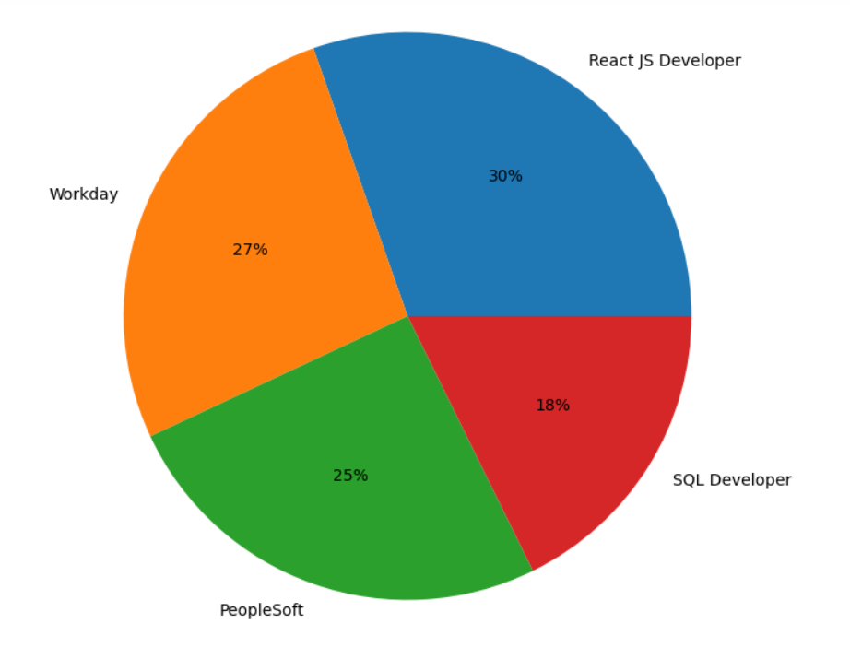
Number and percentage of different category resume files

Slide 7
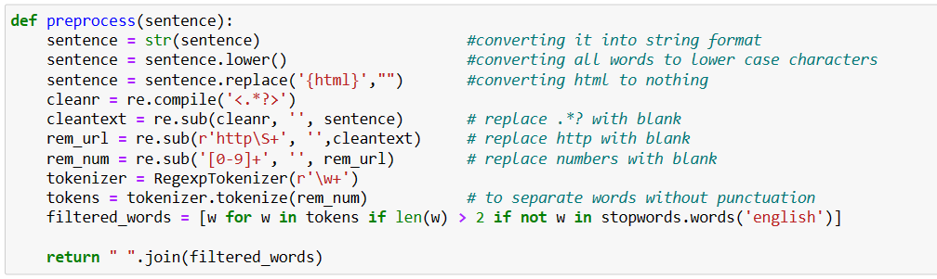
Data Preprocessing
Converting the text into string format.
Convert the characters into lower case.
Replace all html tags into blank space.
Replace punctuations into blank space.
Substitute http tags into blank space.
Substitute all numbers into blank space.
Use RegexpTokenizer to tokenize the text into words. It works by compiling our pattern, then calling re.findall()on our text. We could utilize this function to match alphanumeric tokens plus single quotes
Remove the stopwords.

Slide 8
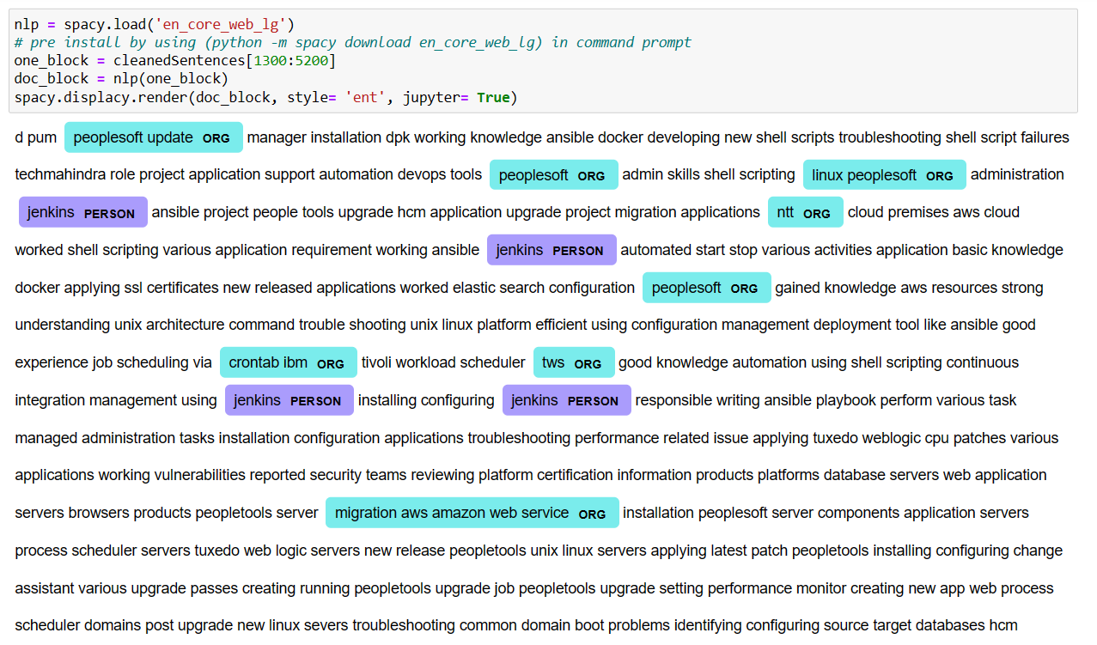
Named Entity Recognition
NER involves detecting and categorizing important information in text known as named entities.
An entity is basically the thing that is consistently talked about or refer to in the text.
Some of the categories that are the most important architecture in NER such that:
Person
Organization
Place/ location
We use spacy module for NER

Slide 9
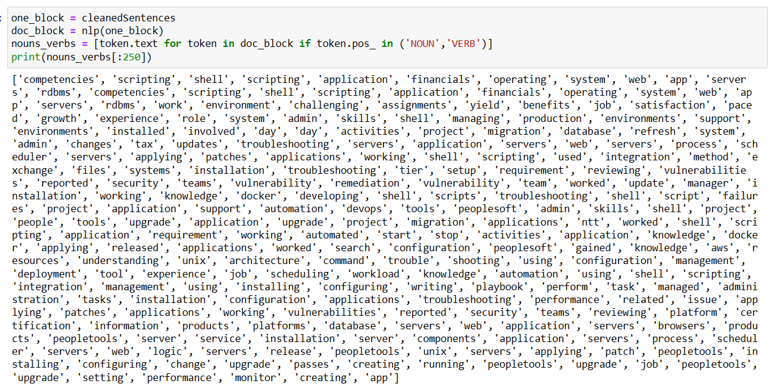
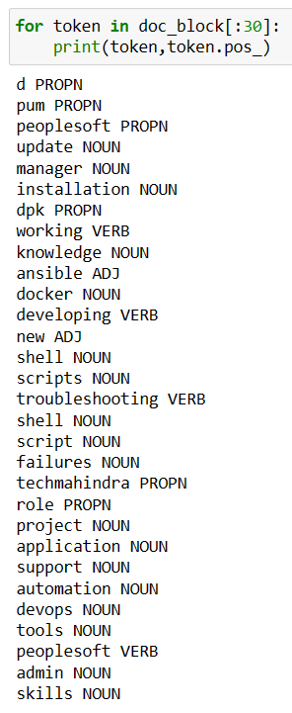
PARTS OF SPEECH(POS) RECOGNITION
POS tagging is a process in natural language processing (NLP) where each word in a text is labeled with its corresponding part of speech.
This can include nouns, verbs, adjectives, and other grammatical categories.
Basically we are interested in only Nouns and Verbs
So we separate the words which are Nouns and Verbs with the help of token.pos_ tag which is used from spacy module

Slide 10
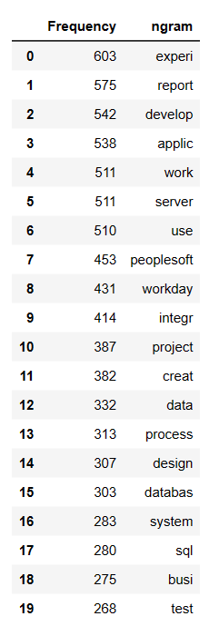
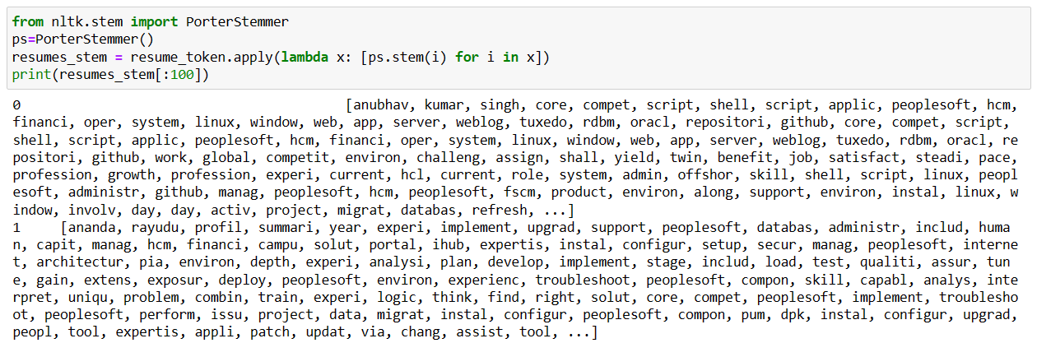
Stemming
Stemming is a natural language processing technique that is used to reduce words to their base form, also known as the root form.
The Porter stemmer is the most widely used algorithm, and it is based on a set of heuristics that are used to remove common suffixes from words.
Some disadvantages of stemming are: It can lead to a loss of information and make it more difficult to analyze text. For example, the word “experience” and “application” may be stemmed to “experi" and "applic" which does not convey the meaning of the original words.
So we move on to Lemmatization which is better than stemming and it also conveys the context of the word.

Slide 11
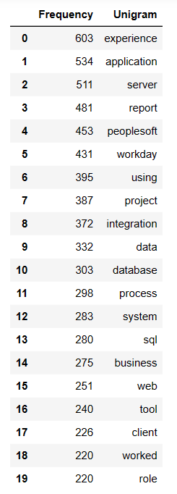
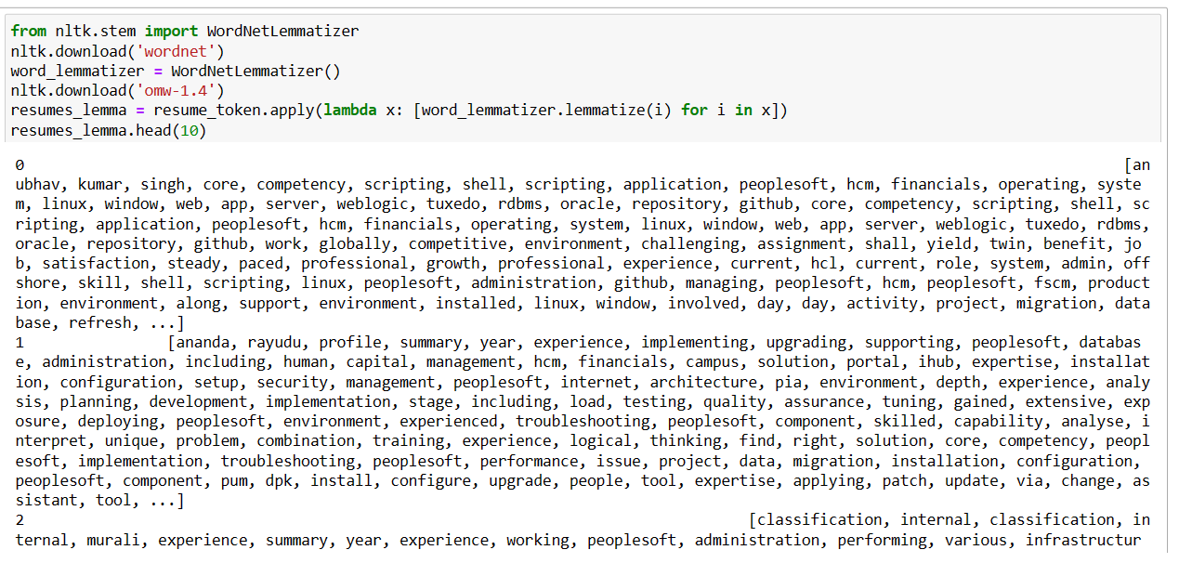
Lemmatization
Lemmatization is the process of grouping together the different inflected forms of a word so they can be analyzed as a single item.
Lemmatization is similar to stemming but it brings context to the words. So it links words with similar meanings to one word.
One of its modules is the WordNet Lemmatizer
Advantages of Lemmatization with NLTK:
Improves text analysis accuracy.
Reduces data size
Better search results
Useful for feature extraction

Slide 12
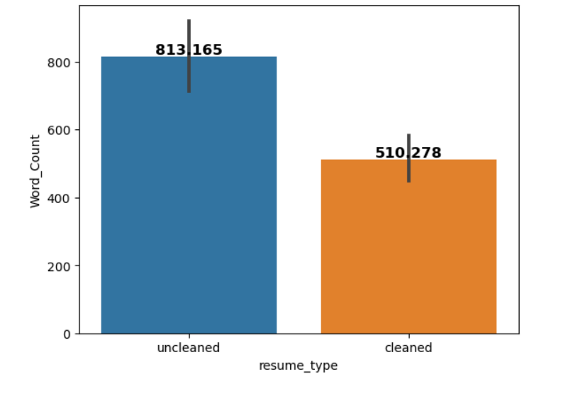
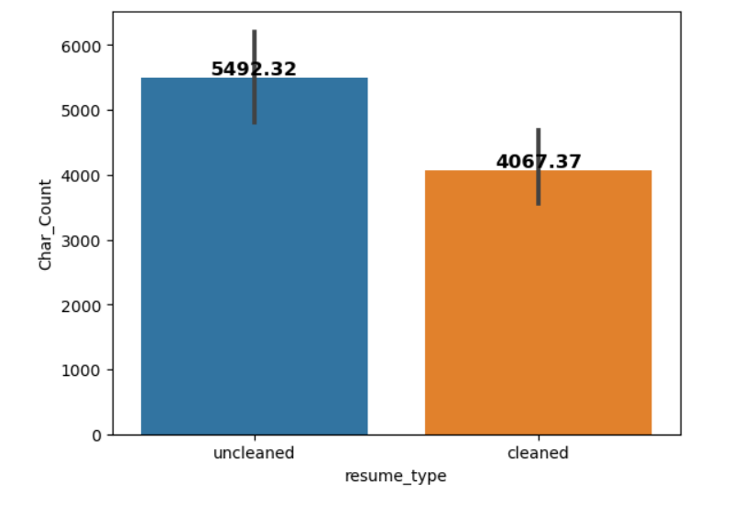
NUMBER OF WORDS AND CHARACTERS BEFORE AND AFTER CLEANING
Around 300 words were removed
Around 1450 characters were removed

Slide 13
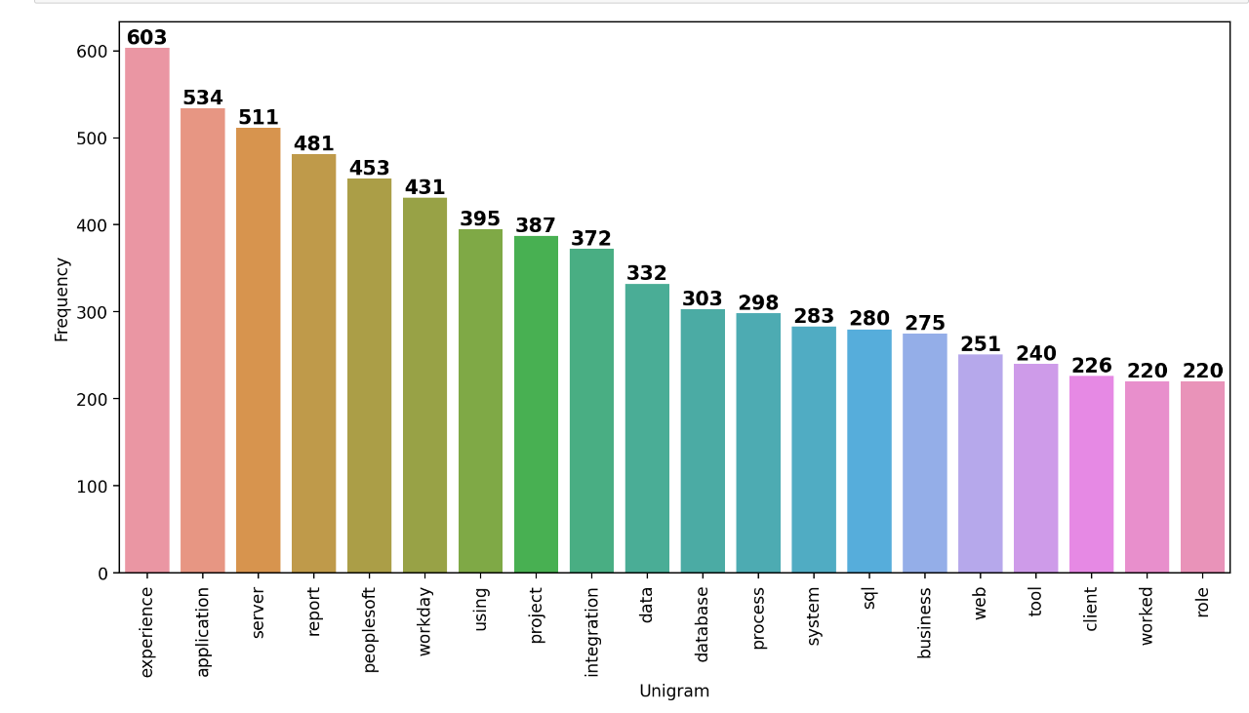
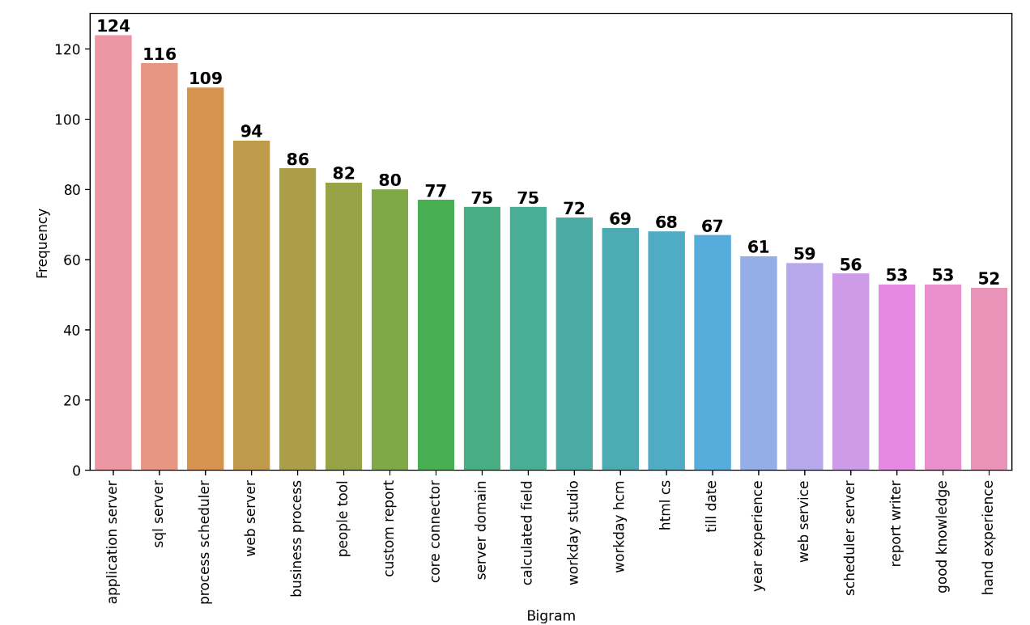
Creating n-grams using Count Vectorizer
UNIGRAM
BIGRAM

Slide 14
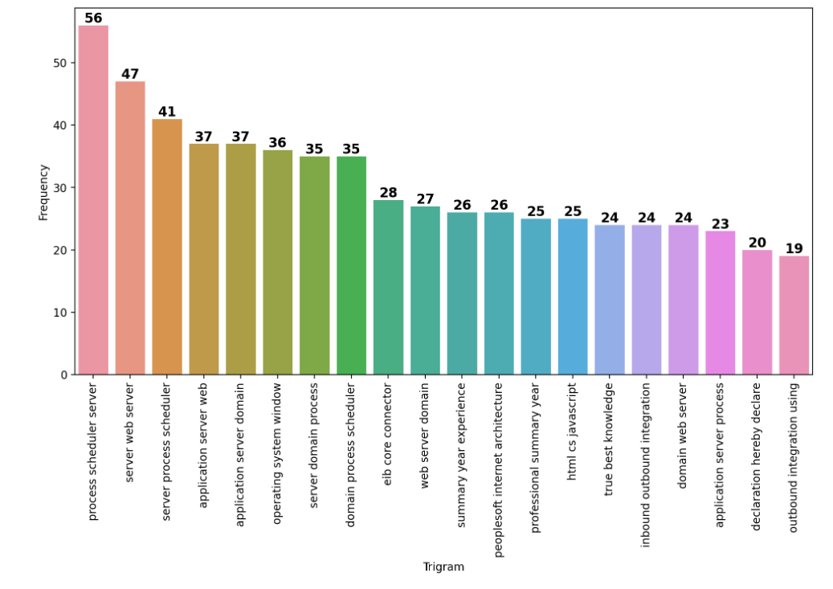
Creating n-grams using Count Vectorizer
TRIGRAM
CountVectorizer is a great tool provided by the sklearn library in Python.
It is used to transform a given text into a vector on the basis of the frequency (count) of each word that occurs in the entire text.
We can create n-grams using count vectorizer
Here we focus on only three types:
Unigram – frequency of only single words.
Bigram – frequency of double words.
Trigram - frequency of triple words.

Slide 15
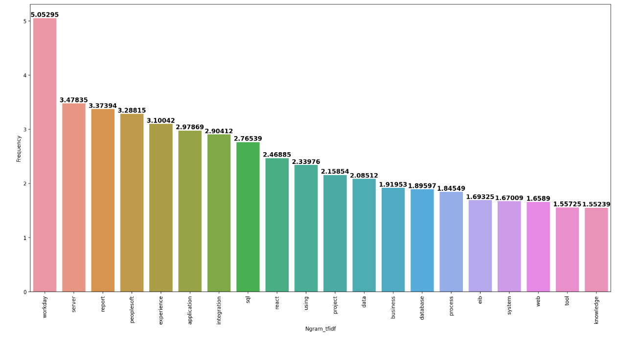
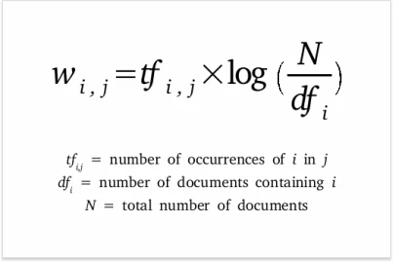
Creating n-grams using TF-IDF Vectorizer
TF-IDF stands for Term Frequency Inverse Document Frequency of records.
It can be defined as the calculation of how relevant a word in a series or corpus is to a text. The meaning increases proportionally to the number of times in the text a word appears but is compensated by the word frequency in the corpus

Slide 16
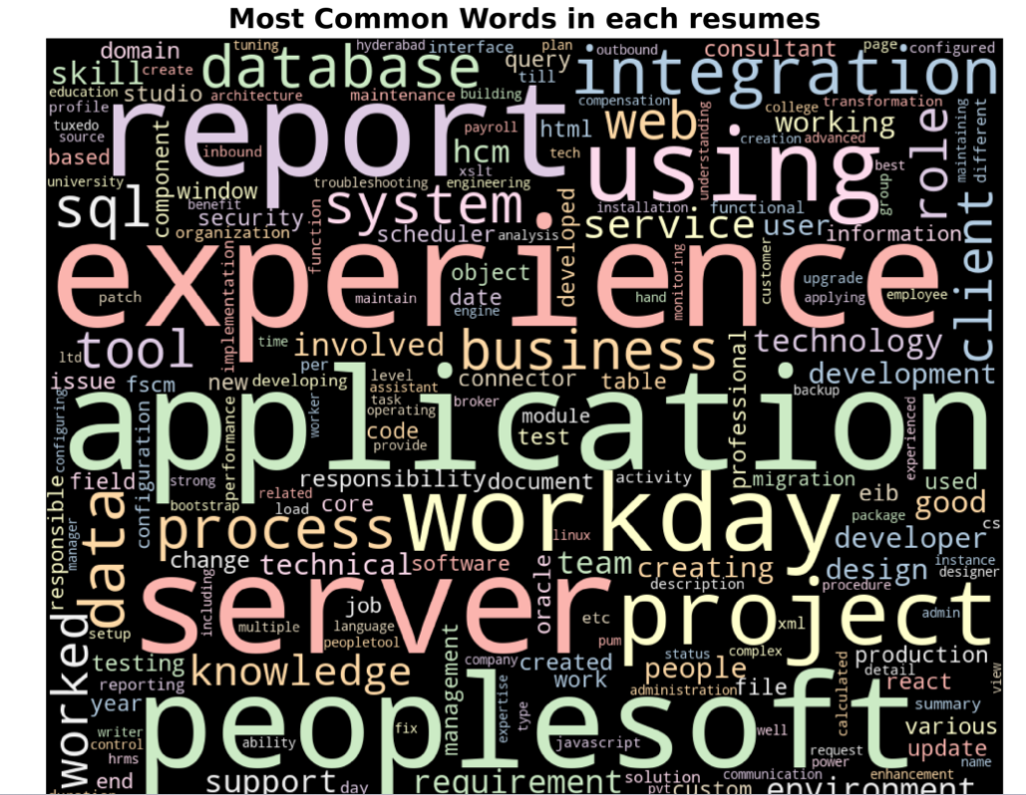
WORD CLOUD

Slide 17
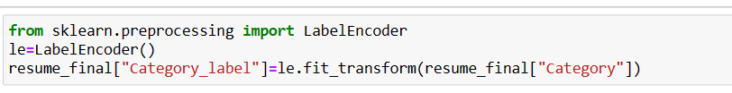
LABEL ENCODING
Category is encoded using Label Encoder.
There are four types of category
0 --> Peoplesoft resumes
1 --> ReactJS resumes
2 --> SQL Developer resumes
3 --> Workday resumes

Slide 18
MODEL BUILDING
WE USE DIFFERENT SUPERVISED LEARNING TECHNIQUES FOR MODEL BUILDING
LOGISTIC REGRESSION
NAÏVE BAYES
DECISION TREES
SUPPORT VECTOR MACHINES (SVM).
RANDOM FOREST
ADABOOST TECHNIQUE
GRADIENT BOOSTING
XG BOOSTING
LG BOOSTING
WE USE TFIDF VECTORIZER TO CONVERT INPUT DATA(TEXT) INTO VECTORS OF REAL NUMBERS.
IN EACH OF THE ABOVE TECHNIQUES WE USE TRAIN-TEST SPLIT.
OUR MODEL WILL BE WELL TRAINED ON TRAINING DATASET AND WE PREDICT THE RESULT USING TEST DATASET.

Slide 19
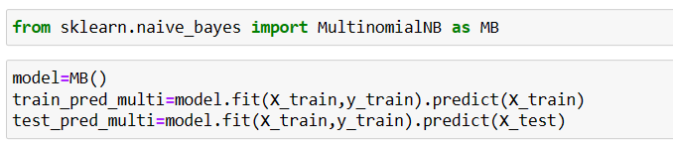
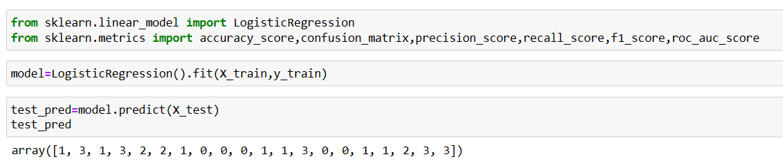
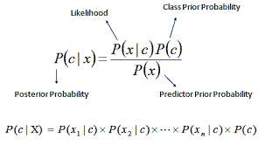
LOGISTIC REGRESSION
NAÏVE BAYES
Naïve Bayes is based on Bayes theorem with the "naïve" assumption of conditional independence between every pair of features given the value of class variable.
Logistic regression estimates the probability of an event occurring, such as voted or didn't vote, based on a given dataset of independent variables.
Logistic Regression is used when the dependent variable(target) is categorical.

Slide 20
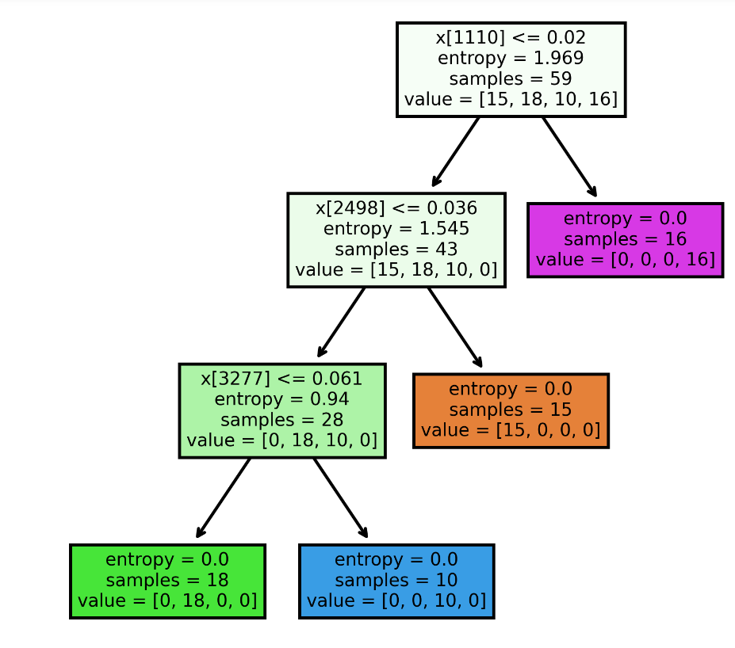
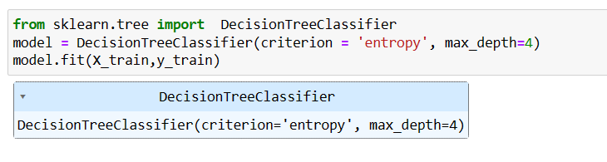
DECISION TREES
Decision tree has a hierarchical, tree structure, which consists of a root node, branches, internal nodes and leaf nodes.
It is constructed by recursively splitting the training data into subsets based on the values of the attributes until a stopping criterion is met, such as the maximum depth of the tree or the minimum number of samples required to split a node.
It split the data based on a metric such as entropy which measures the level of impurity or randomness in the subsets. The goal is to find the attribute that maximizes the information gain or the reduction in impurity after the split.

Slide 21
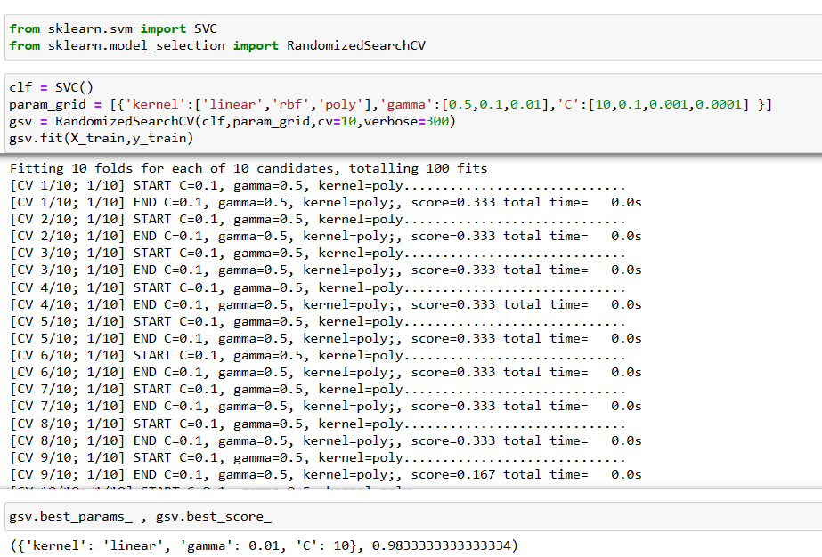
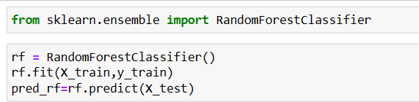
SUPPORT VECTOR MACHINES(SVM)
RANDOM FOREST
Random forest combines the output of multiple decision trees to reach a single result.
By combining the outputs of these trees, the random forest algorithm delivers a consolidated and more accurate result.
The main objective of the SVM algorithm is to find the optimal hyperplane in an N-dimensional space that can separate the data points in different classes in the feature space.
Different kernels in SVM are :- ‘linear’, ‘poly’, ‘rbf’, ‘sigmoid’
C is a Regularization parameter and gamma is a kernel coefficient
We use Randomized search to get the best parameters (kernel,C,gamma) and best score

Slide 22
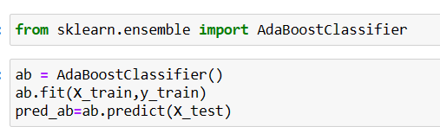
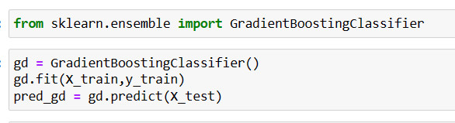
BOOSTING
AdaBoost
Gradient Boosting
Gradient Boosting combines several weak learners into strong learners, in which each new model is trained to minimize the loss function such as mean squared error or cross-entropy of the previous model using gradient descent.
In each iteration, the algorithm computes the gradient of the loss function with respect to the predictions of the current ensemble and then trains a new weak model to minimize this gradient.
The predictions of the new model are then added to the ensemble, and the process is repeated until a stopping criterion is met.
AdaBoost is a boosting algorithm that works on the principle of the stagewise addition method where multiple weak learners are used for getting strong learners.
It builds a model and gives equal weights to all the data points. It then assigns higher weights to points that are wrongly classified.
Now all the points with higher weights are given more importance in the next model. It will keep training models until and unless a lower error is received.

Slide 23
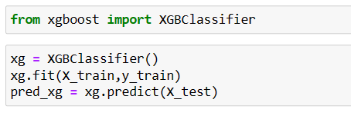
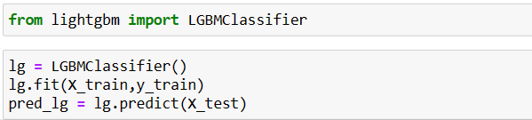
BOOSTING
XGBoost Machine
LGBoost Machine
XGBoost stands for “Extreme Gradient Boosting”
It is widely used machine learning algorithms due to its ability to handle large datasets
Weights are assigned to all the independent variables which are then fed into the decision tree which predicts results.
The weight of variables predicted wrong by the tree is increased and these variables are then fed to the second decision tree.
These individual classifiers/predictors then ensemble to give a strong and more precise model.
LGBoost stands for Light Gradient Boost Machine.
It uses tree based learning algorithm.
Light GBM grows tree vertically while other algorithm grows trees horizontally meaning that Light GBM grows tree leaf-wise while other algorithm grows level-wise.
It will choose the leaf with max delta loss to grow. When growing the same leaf, Leaf-wise algorithm can reduce more loss than a level-wise algorithm.

Slide 24
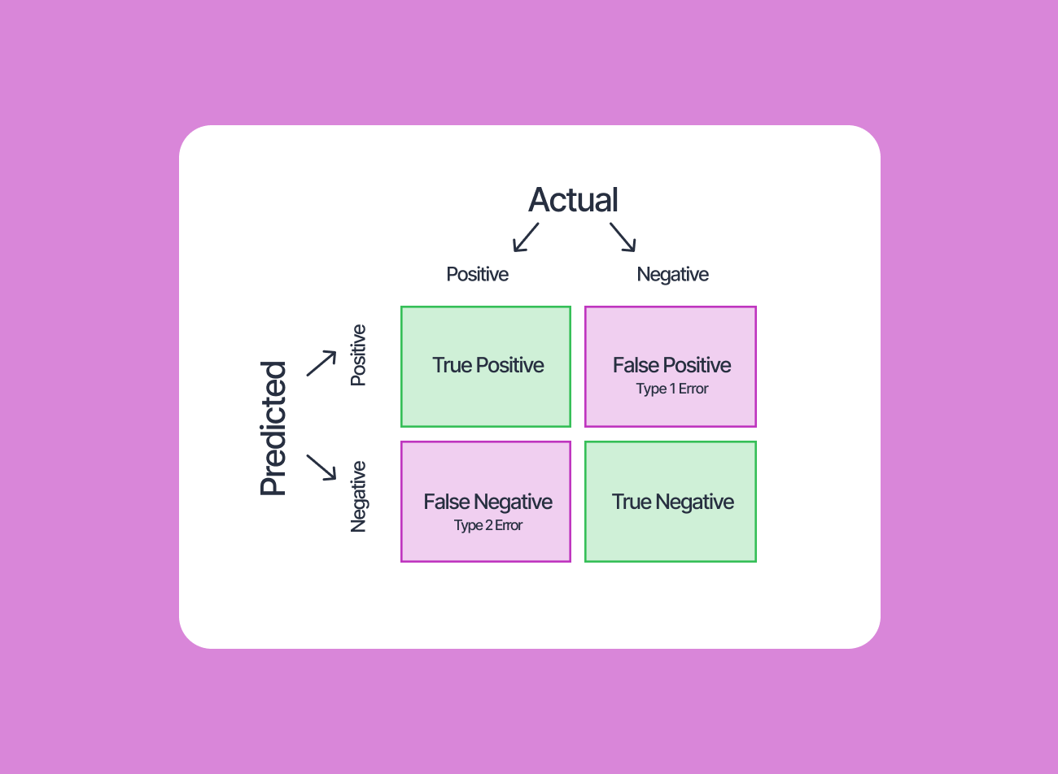
MODEL EVALUATION
For model evaluation we use four evaluation metrics.
Accuracy:- It is simply the ratio of all correctly predicted cases whether positive or negative and all cases in the data. Accuracy = (TP+TN) / (TP+FP+FN+TN))
Precision:- It is the ratio of correctly predicted positive cases vs. all predicted positive cases. Precision = (TP / (TP + FP))
Recall:- Recall or sensitivity is the ratio of all correctly identified positive cases divided by all actually positive cases. Recall = (TP / (TP + FN))
F1-score:- The F1 Score is the weighted average of precision and recall, hence it takes both false positives and false negatives into account. F1-score = 2*TP/(2*TP+FP+FN)
Confusion Matrix:-
A confusion matrix is a table that is used to define the
performance of a classification algorithm.
The matrix displays the number of true positives (TP),
true negatives (TN),false positives (FP), and
false negatives (FN) produced by the model
on the test data.

Slide 25
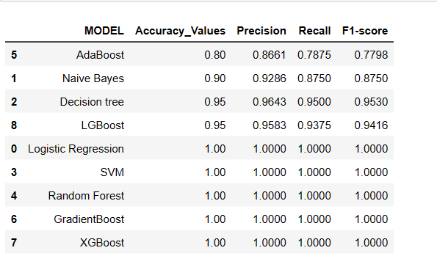
FINAL EVALAUATION METRICS AND CONCLUSIONS
Firstly we see whose accuracy values are high, Excluding AdaBoost and Naïve bayes other models have high accuracy.
Then we see SVM, RF, GBM, XGBM, LR have 100% accuracy which leads to overfitting so we don’t consider these.
Then we see LGBM, DT have same accuracy.
So we finally see F1 score which considers harmonic mean of both precision and recall. Here Decision tree has higher F1-score.
So we consider Decision tree as our final model.

Slide 26
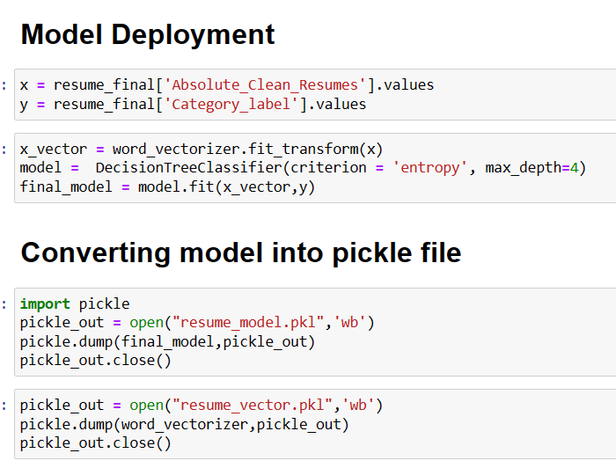
DEPLOYMENT
Firstly assign x and y variables.
Then vectorize the x variable.
Then fit the final model on x and y variable which is decision tree model.
Convert the final model into a pickle file which is the process of converting a Python object into a byte stream to store it in a file/database, maintaining program state across sessions, or transport data over the network.
We also convert the vectorizer which is TF-IDF vector into a pickle file.

Slide 27
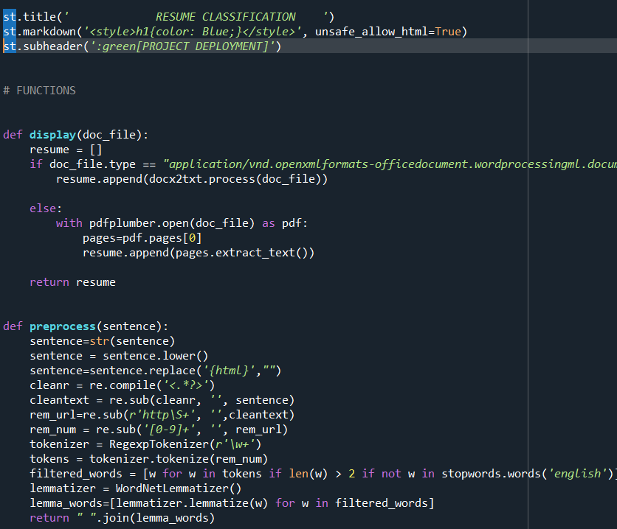
DEPLOYMENT
Firstly give the title and subheader.
Write a function to display the files, if the file is in .docx format we use docx2txt module to convert docx to text and also use pdfplumber module to convert pdf file into text format.
Also write preprocess function which cleans the text.
Convert text into string, lower case characters.
Convert puntuations, html, http and numbers into blank.
Tokenize the text using RegexpTokenizer.
Remove stopwords
Lemmatize the text and join all the words.

Slide 28
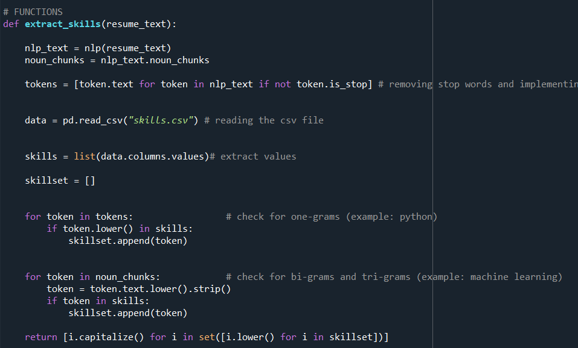
DEPLOYMENT
Write a function to extract skills from the resumes.
Firstly take out all the nouns from the text.
Take the reference of skills from skills.csv file from the internet
If the skills are present in both the resume text and also the skills from .csv file then display those skills

Slide 29
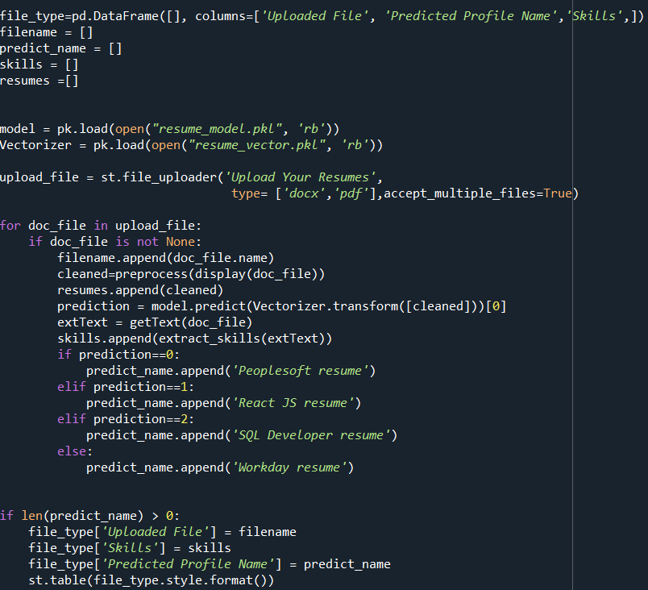
DEPLOYMENT
Create a table with uploaded file name, predicted profile name and skills.
Load the pickle file of model and vectorizer.
Upload the resumes which are in docx or pdf format.
Convert the given file into text then predict on which category it belongs to and provide name and skills based on label.
Then finally show the given output into a table format.

Slide 30
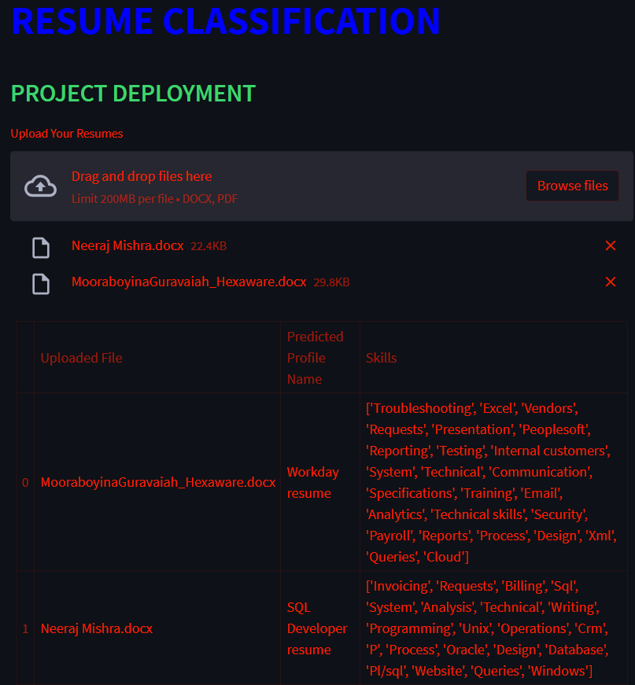
We run the .py file in command prompt using streamlit run filename.py command.
Then we see the file running as local host in the browser.
Here we select the files and then see the output.

Slide 31
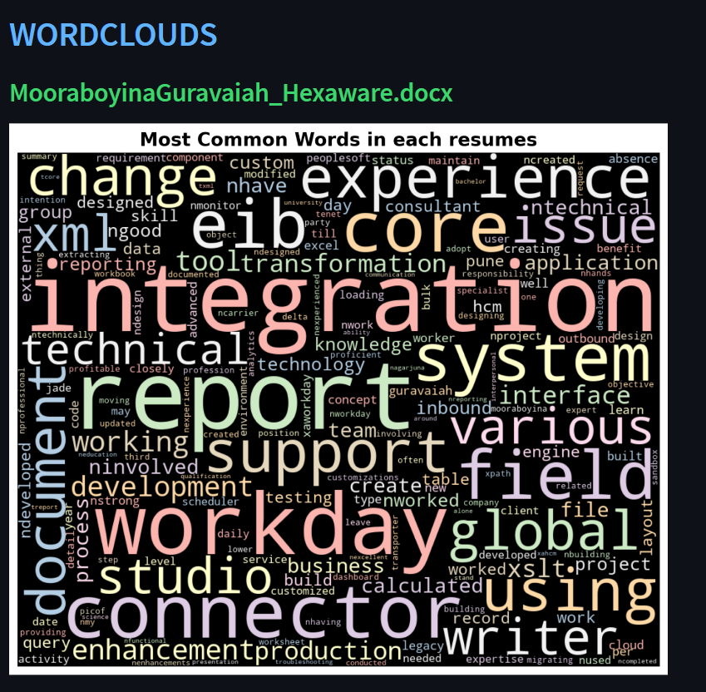

Slide 32
Challenges of the project and their solutions
Firstly the biggest challenge was some of the files that were sent were .doc files, so we were not able to convert those files into text format, so the solution was we converted all the .doc files into .docx files with the help of internet, then those .docx files were converted into text format.
Another challenge was with naming, if we name one table as xyz and another as abc if we want xyz in the upcoming code we would get abc, so we distinctly named everything different and relatable to that topic like for Ex:- resumes which are cleaned are named as cleaned_resumes
Also about the evaluation metrics like accuracy would change whenever we rerun the code, so what we did is if the model is finalized then convert it into pickle file and then don’t rerun the file once again.

Slide 33

THANK YOU

